Slide 1
zekeLabs
Kafka - Producers
Learning made Simpler ! www.zekeLabs.com

Slide 2
Agenda
Overview
Constructing a Kafka Producer
Configuring Producers
Serializers

Slide 3
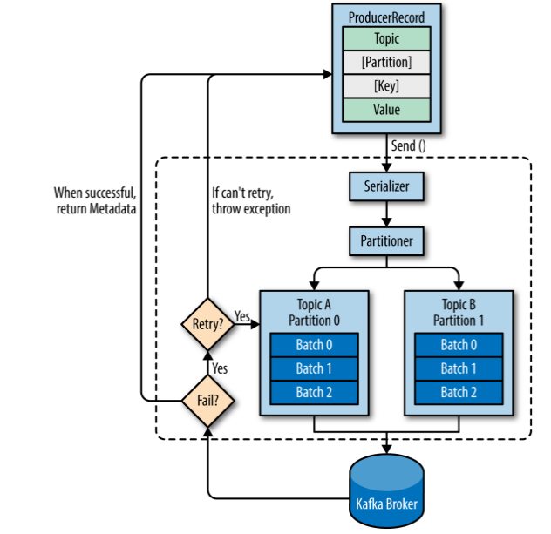
Overview

Slide 4
Constructing a Kafka Producer
bootstrap.servers
key.serializer
value.serializer

Slide 5
Configuring Producers
acks - 0,1, all
compression.type
retries
batch.size
linger.ms
client.id
max.in.flight.requests.per.connection
max.request.size

Slide 6
Serializers
Key Can be serialized
Value can be serialized
Using custom partitioner, all the data can be sent to custom partitioner

Slide 7
Thank You !!!

Slide 8
THANK YOU
Let us know how can we help your organization to Upskill the employees to stay updated in the ever-evolving IT Industry.
Get in touch:
www.zekeLabs.com | +91-8095465880 | info@zekeLabs.com
Visit : www.zekeLabs.com for more details

